Slide 1
FOCP – II
End Semester Project

Slide 2
Blood Bank Management System
Java Project

Slide 3
By:
Piyush Gambhir (21CSU349)
Shivam Deswal (21CSU091)
Akshayy Hooda (21CSU312)
Akash (21CSU315)
Under the supervision of:
Ms. Ruchika Lalit

Slide 4
Table of Contents
Introduction
Hardware Requirements
Software Requirements
Java Concepts Used
Output

Slide 5
Introduction
The aim of the project is to retrieve, process and store information related to donors and patients. The system inputs the details of patients (name, age, disease, doctor, admitted date, blood group required) and details of donors (name, age, blood group, any disease).

Slide 6
Minimum Hardware Requirements
Processor: Intel Atom® Processor or Intel CoreTM i3 or AMD Ryzen 3
RAM: 2GB
Disk Space: 1GB

Slide 7
Software Requirements
Operating System: Windows, Linux, or MacOS
JDK 18

Slide 8
Java Concepts Used

Slide 9
Scanner Class
Scanner is a class in java.util package used for obtaining the input of the primitive types like int, double, etc. and strings. It is the easiest way to read input in a Java program, though not very efficient if you want an input method for scenarios where time is a constraint like in competitive programming.

Slide 10
Exception Handling
Exception Handling in Java is one of the effective means to handle the runtime errors so that the regular flow of the application can be preserved. Java Exception Handling is a mechanism to handle runtime errors such as ClassNotFoundException, IOException, SQLException, RemoteException, etc.

Slide 11
File Handling
In Java, with the help of File Class, we can work with files. This File Class is inside the java.io package. The File class can be used by creating an object of the class and then specifying the name of the file.

Slide 12
ArrayList
The ArrayList class is a resizable array, which can be found in the java.util package.
The difference between a built-in array and an ArrayList in Java, is that the size of an array cannot be modified (if you want to add or remove elements to/from an array, you must create a new one). While elements can be added and removed from an ArrayList whenever you want.

Slide 13
Output

Slide 14
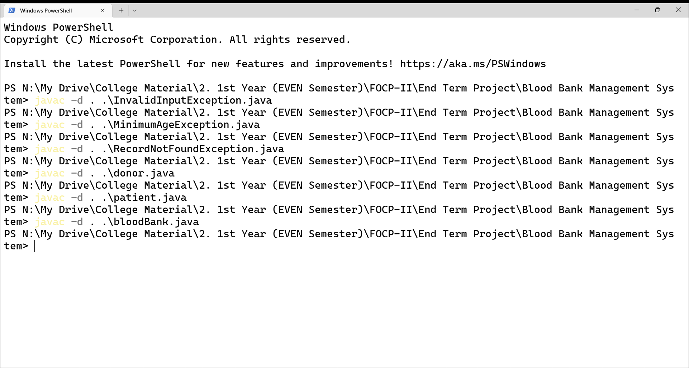

Slide 15
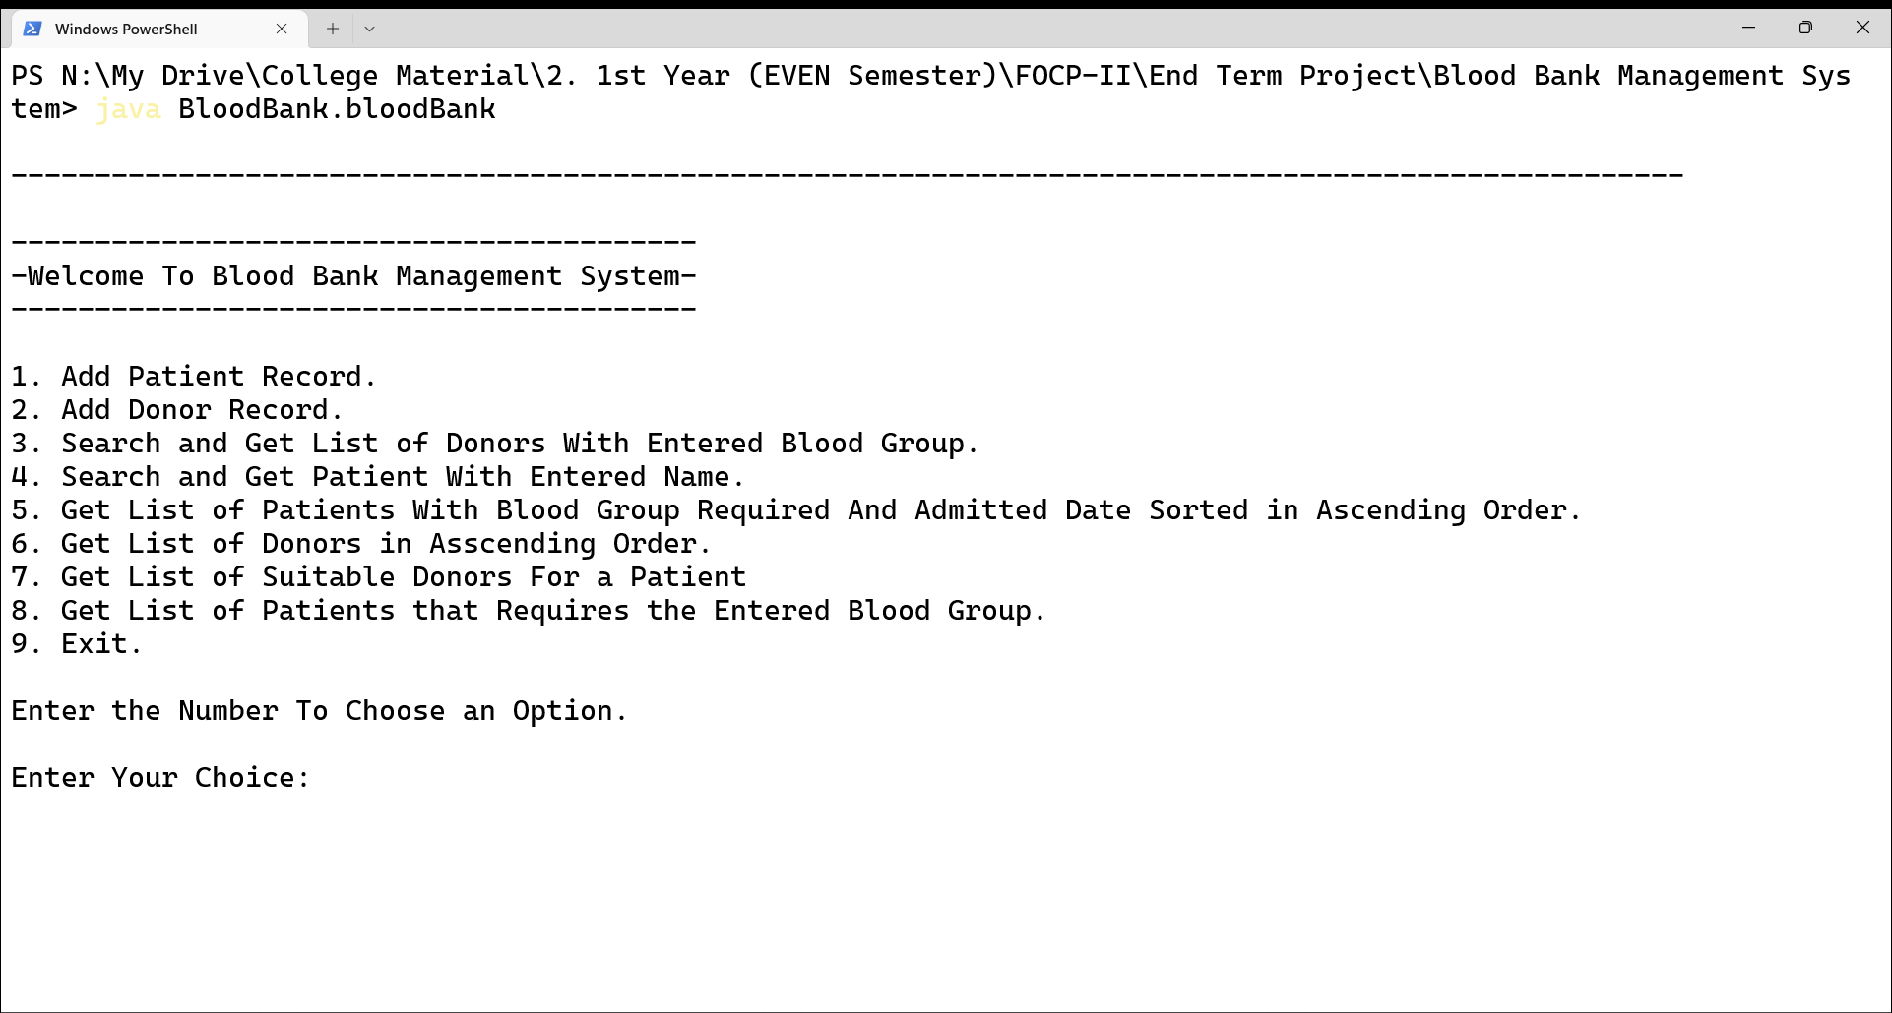

Slide 16
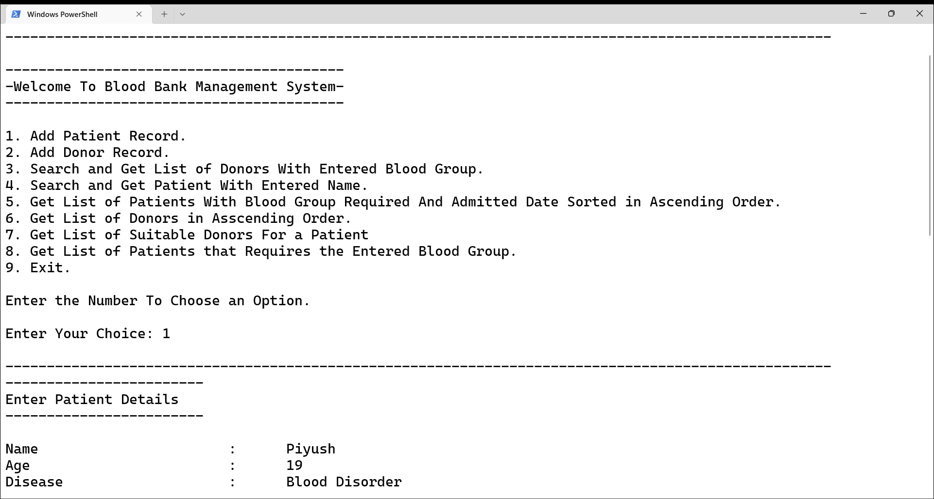

Slide 17
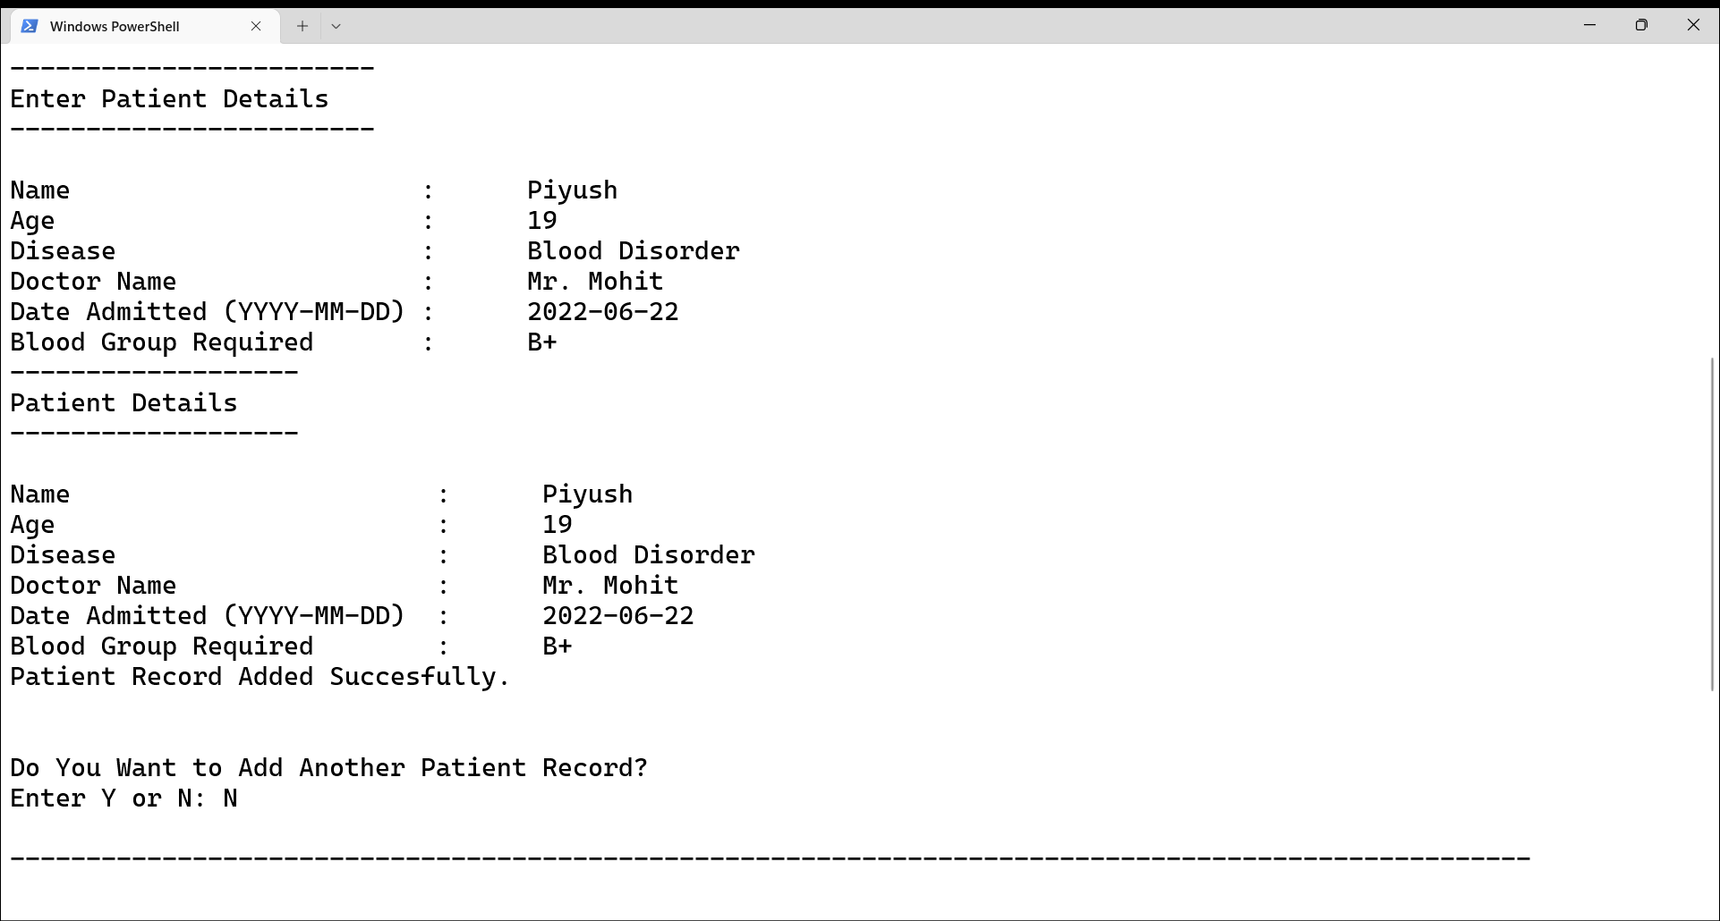

Slide 18
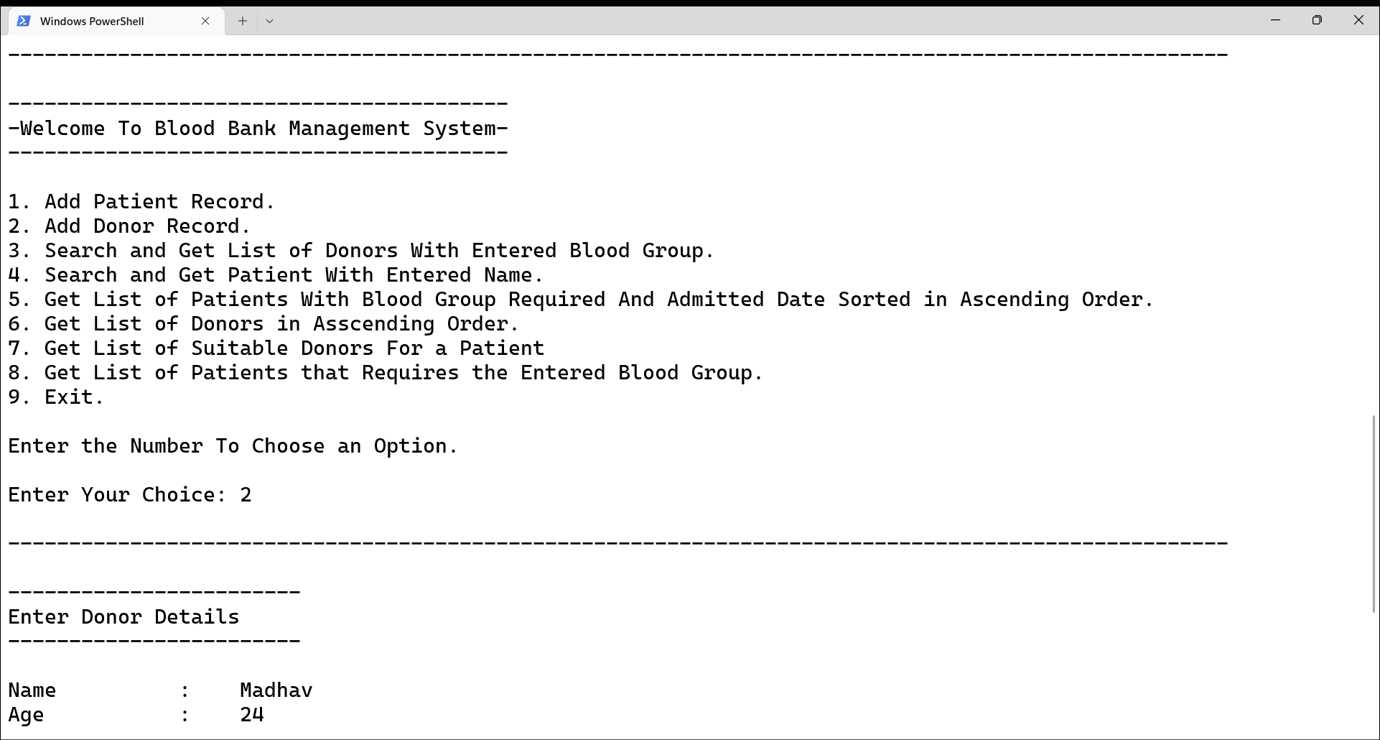

Slide 19
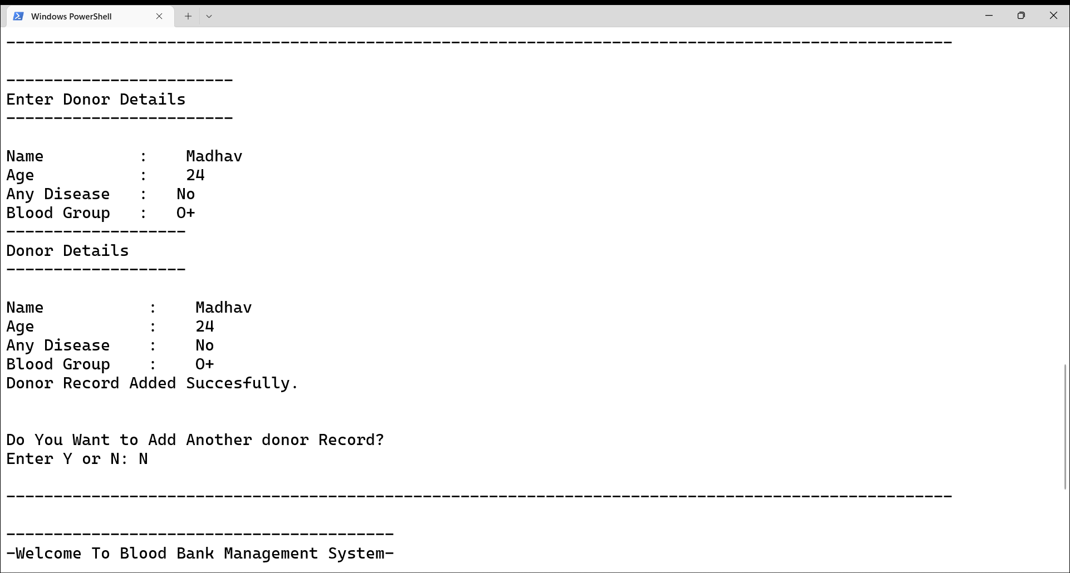

Slide 20
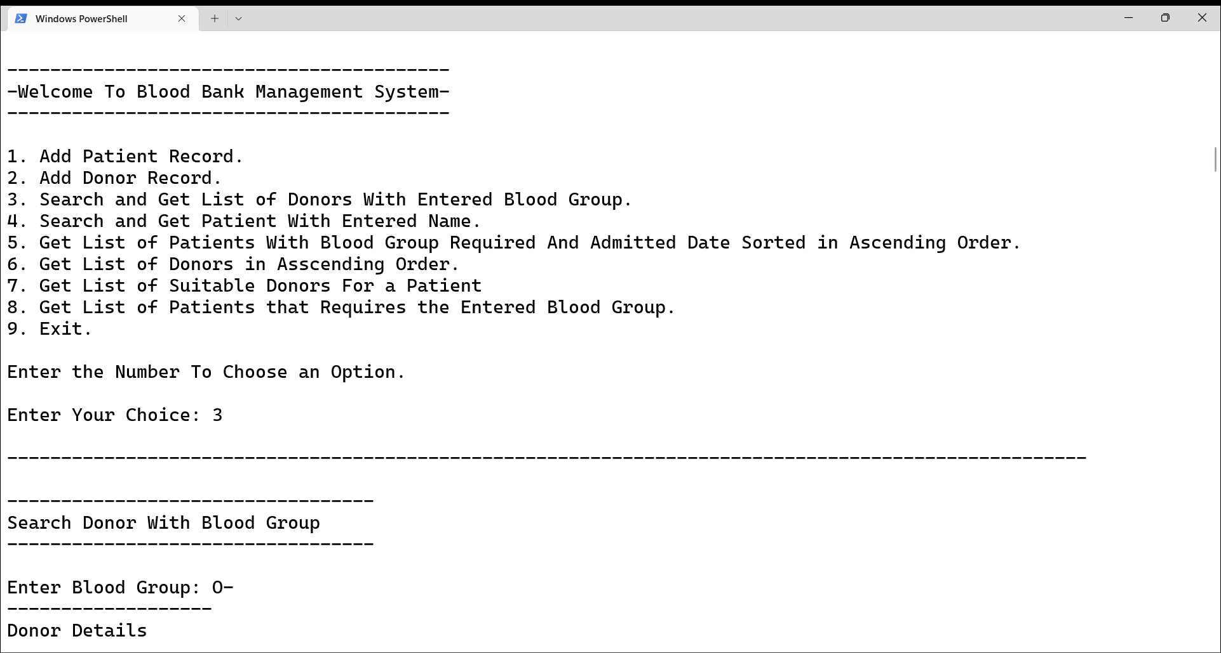

Slide 21
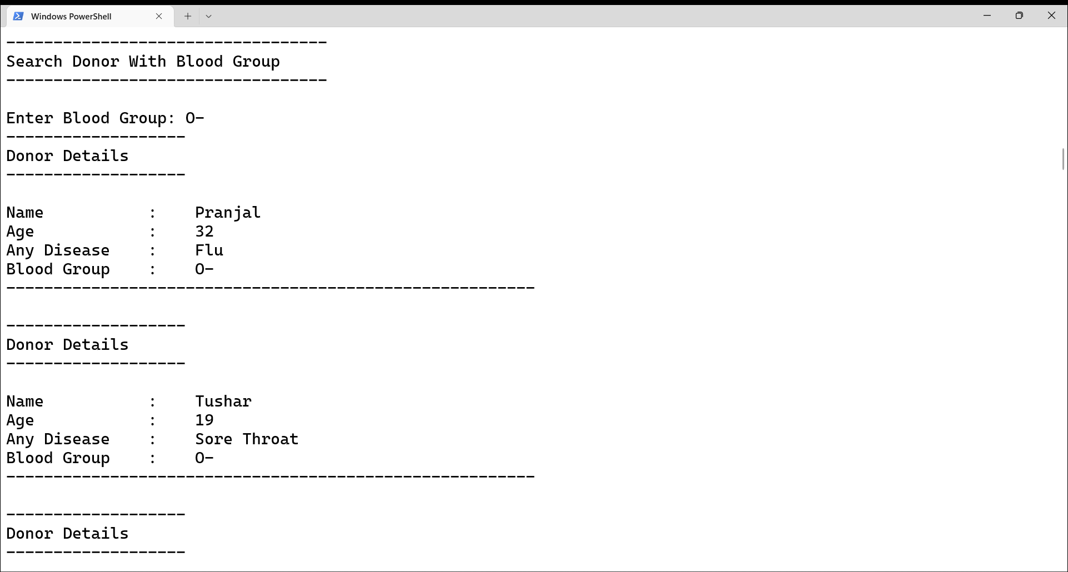

Slide 22
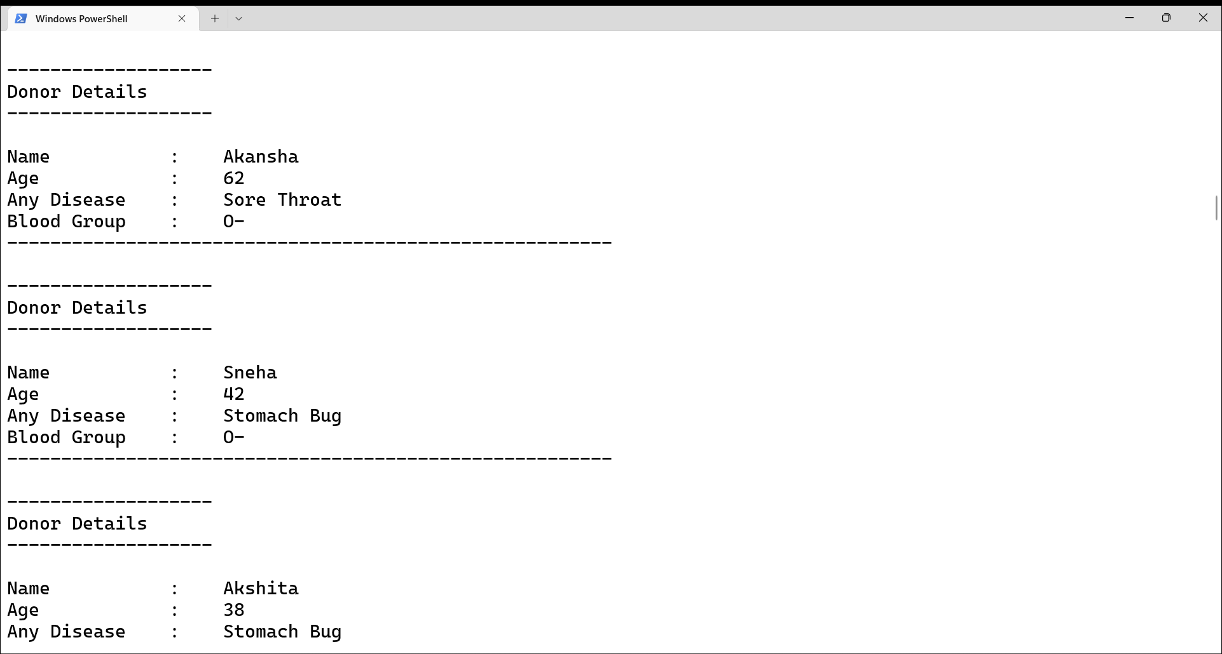

Slide 23
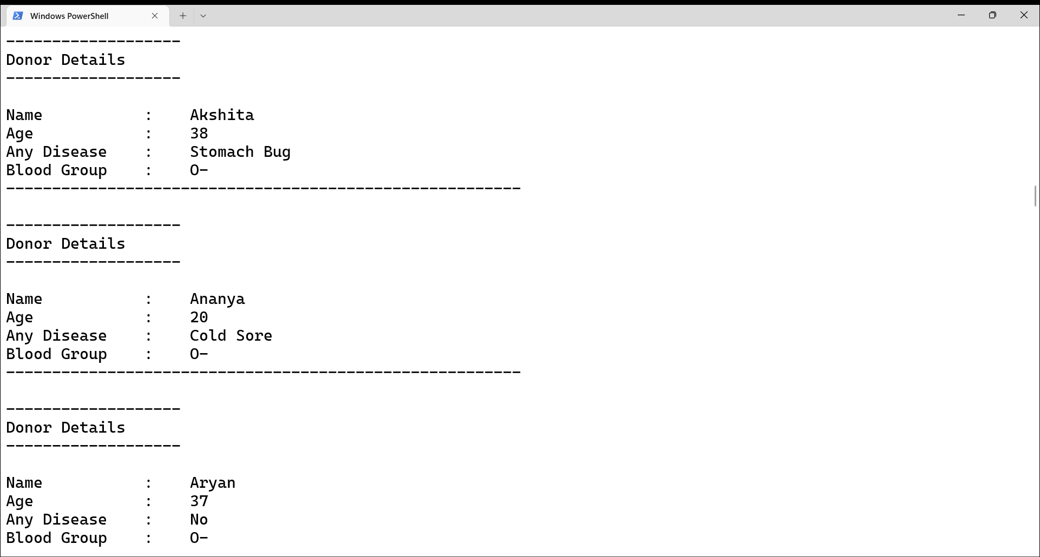

Slide 24
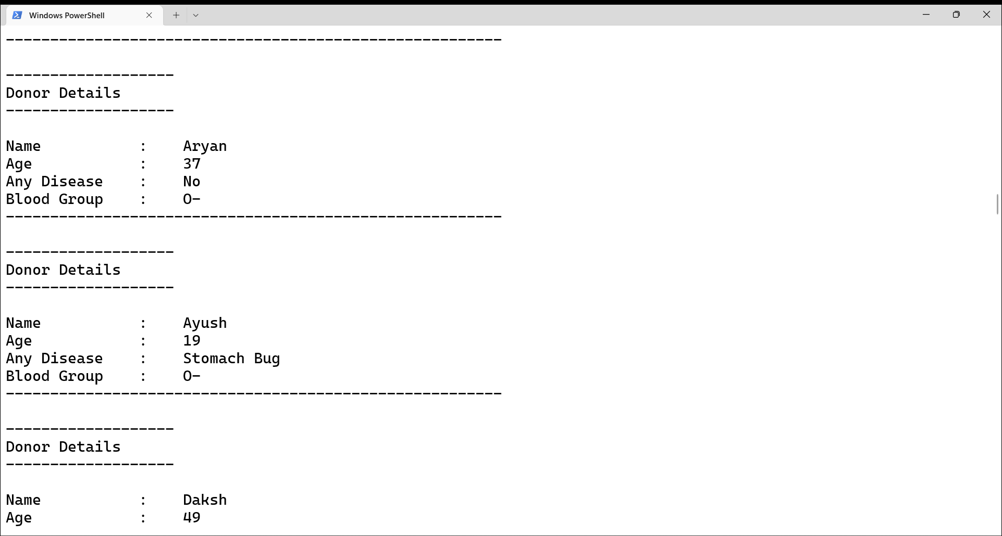

Slide 25
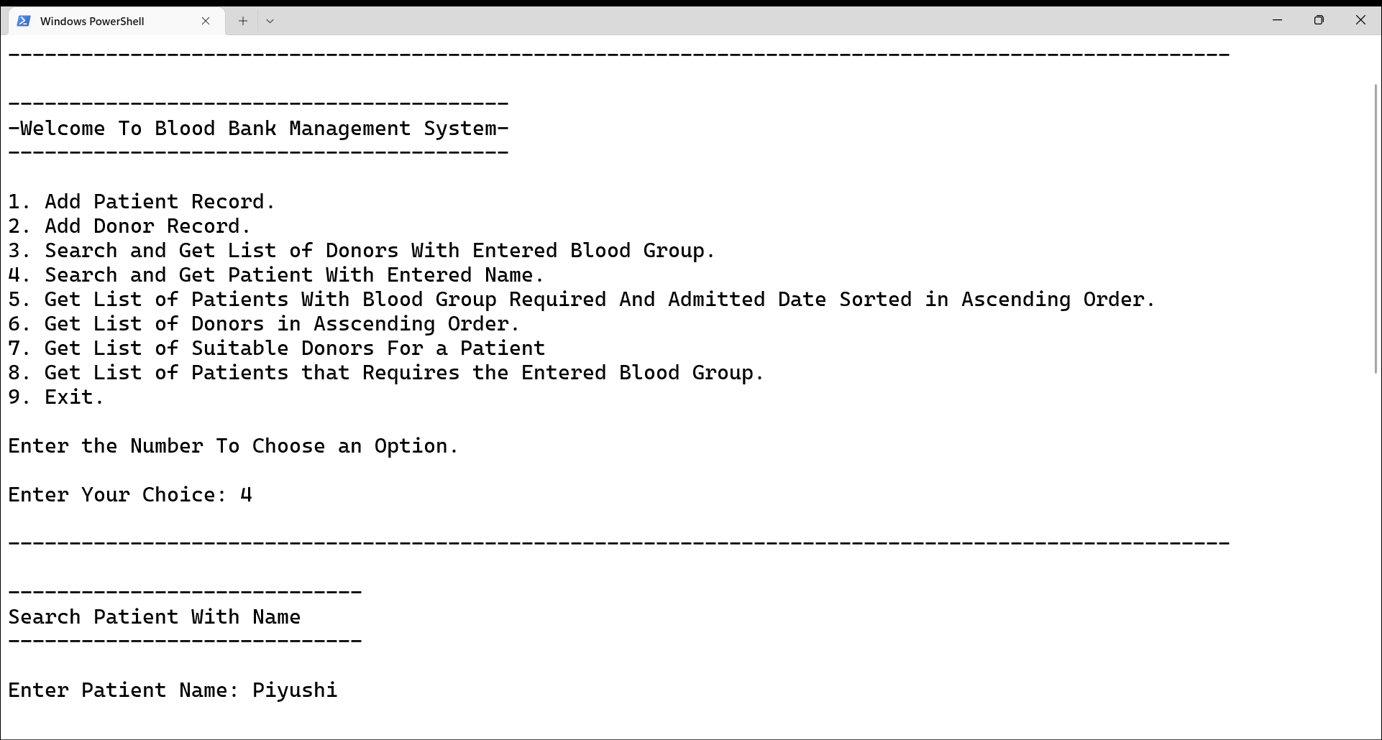

Slide 26
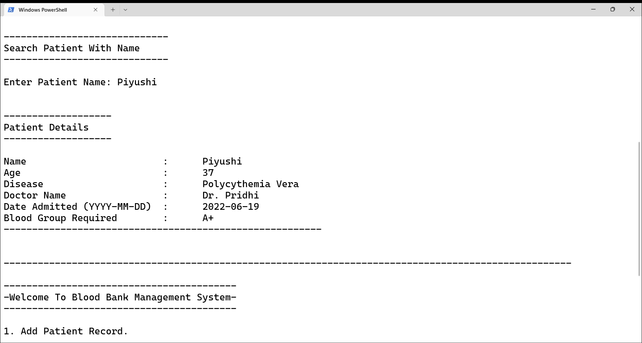

Slide 27
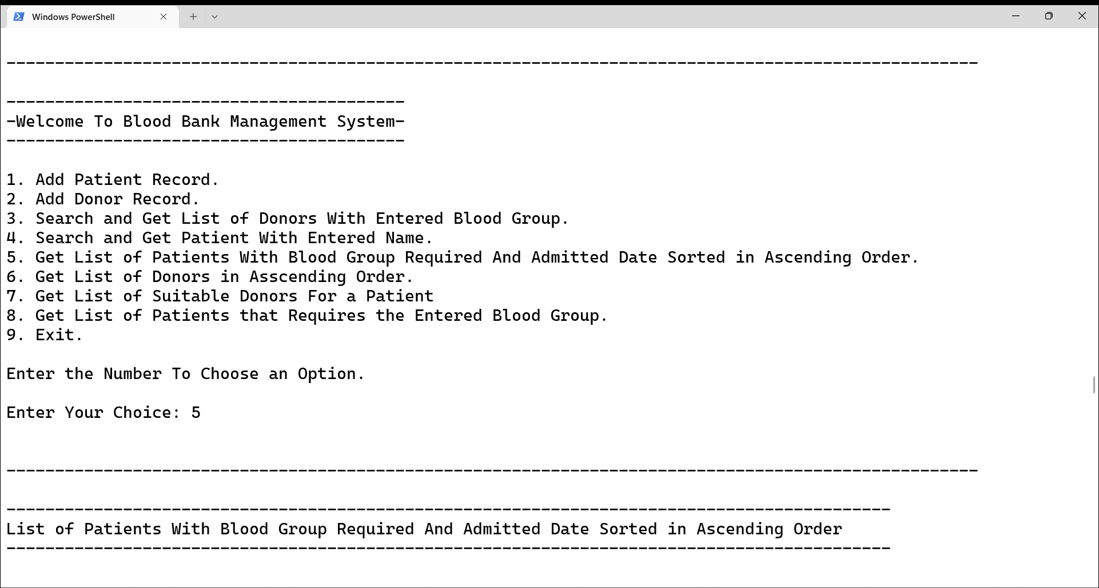

Slide 28
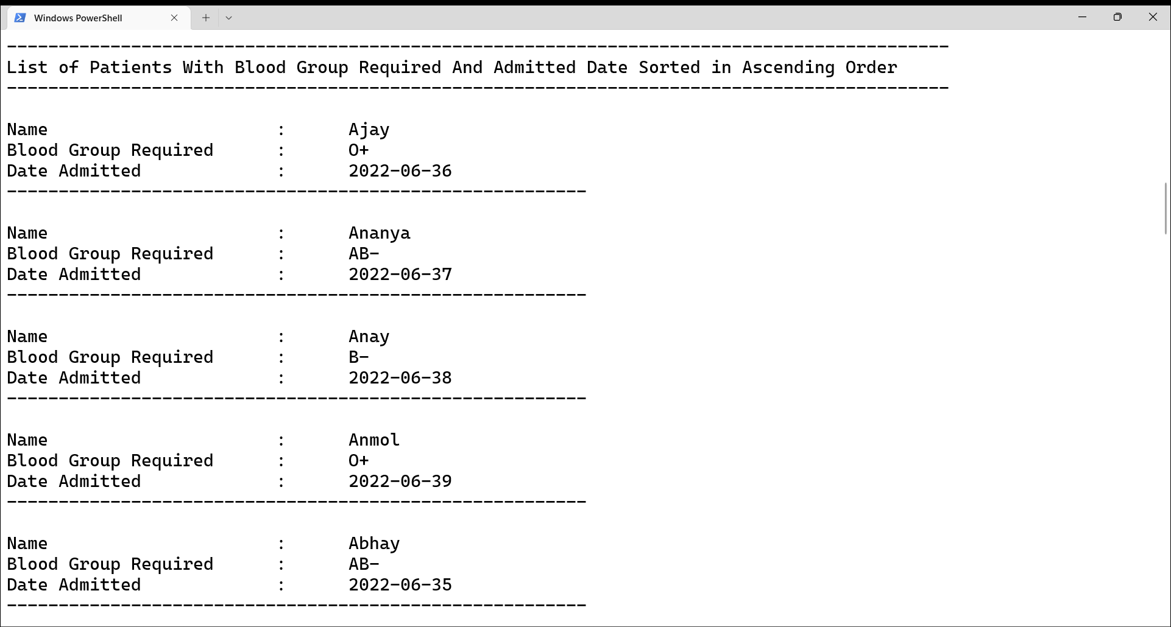

Slide 29
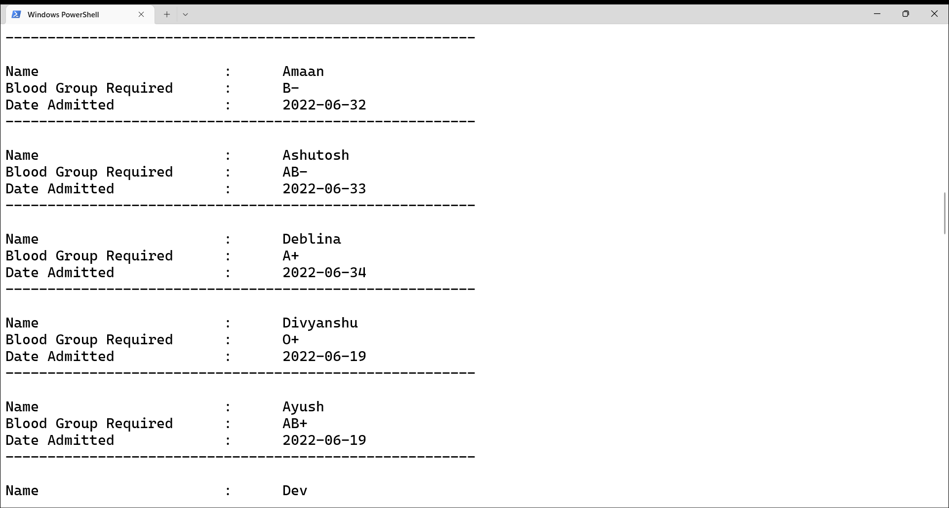

Slide 30
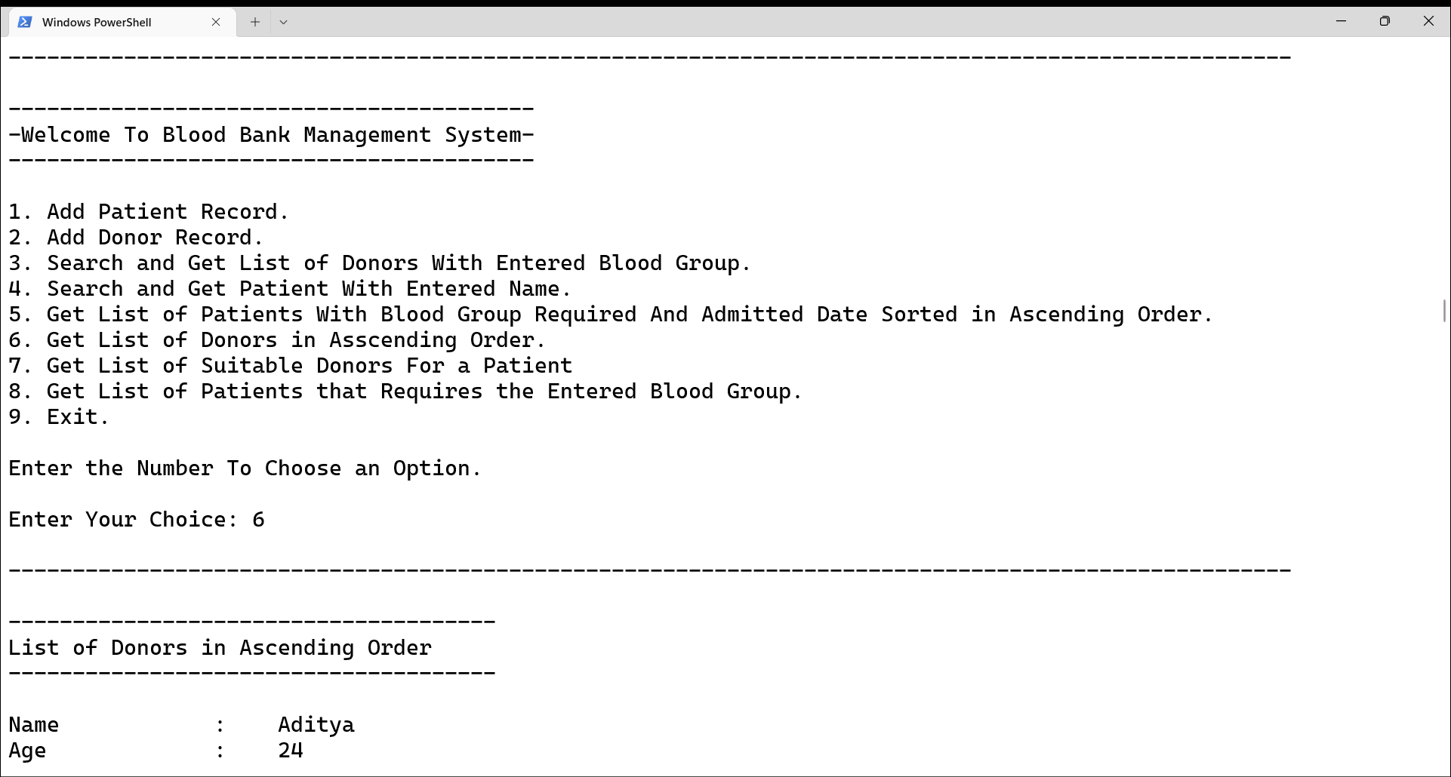

Slide 31
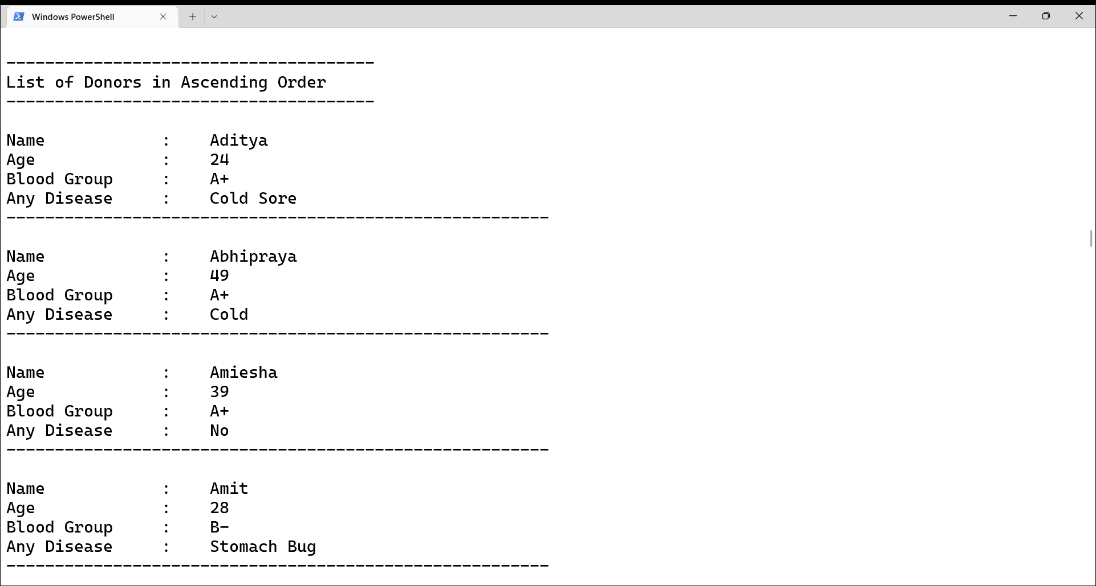

Slide 32
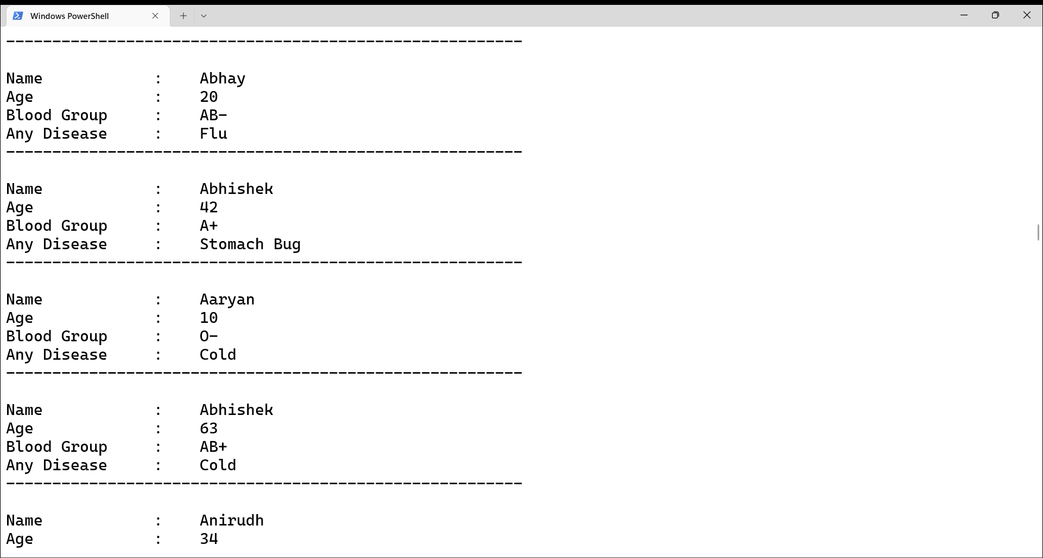

Slide 33
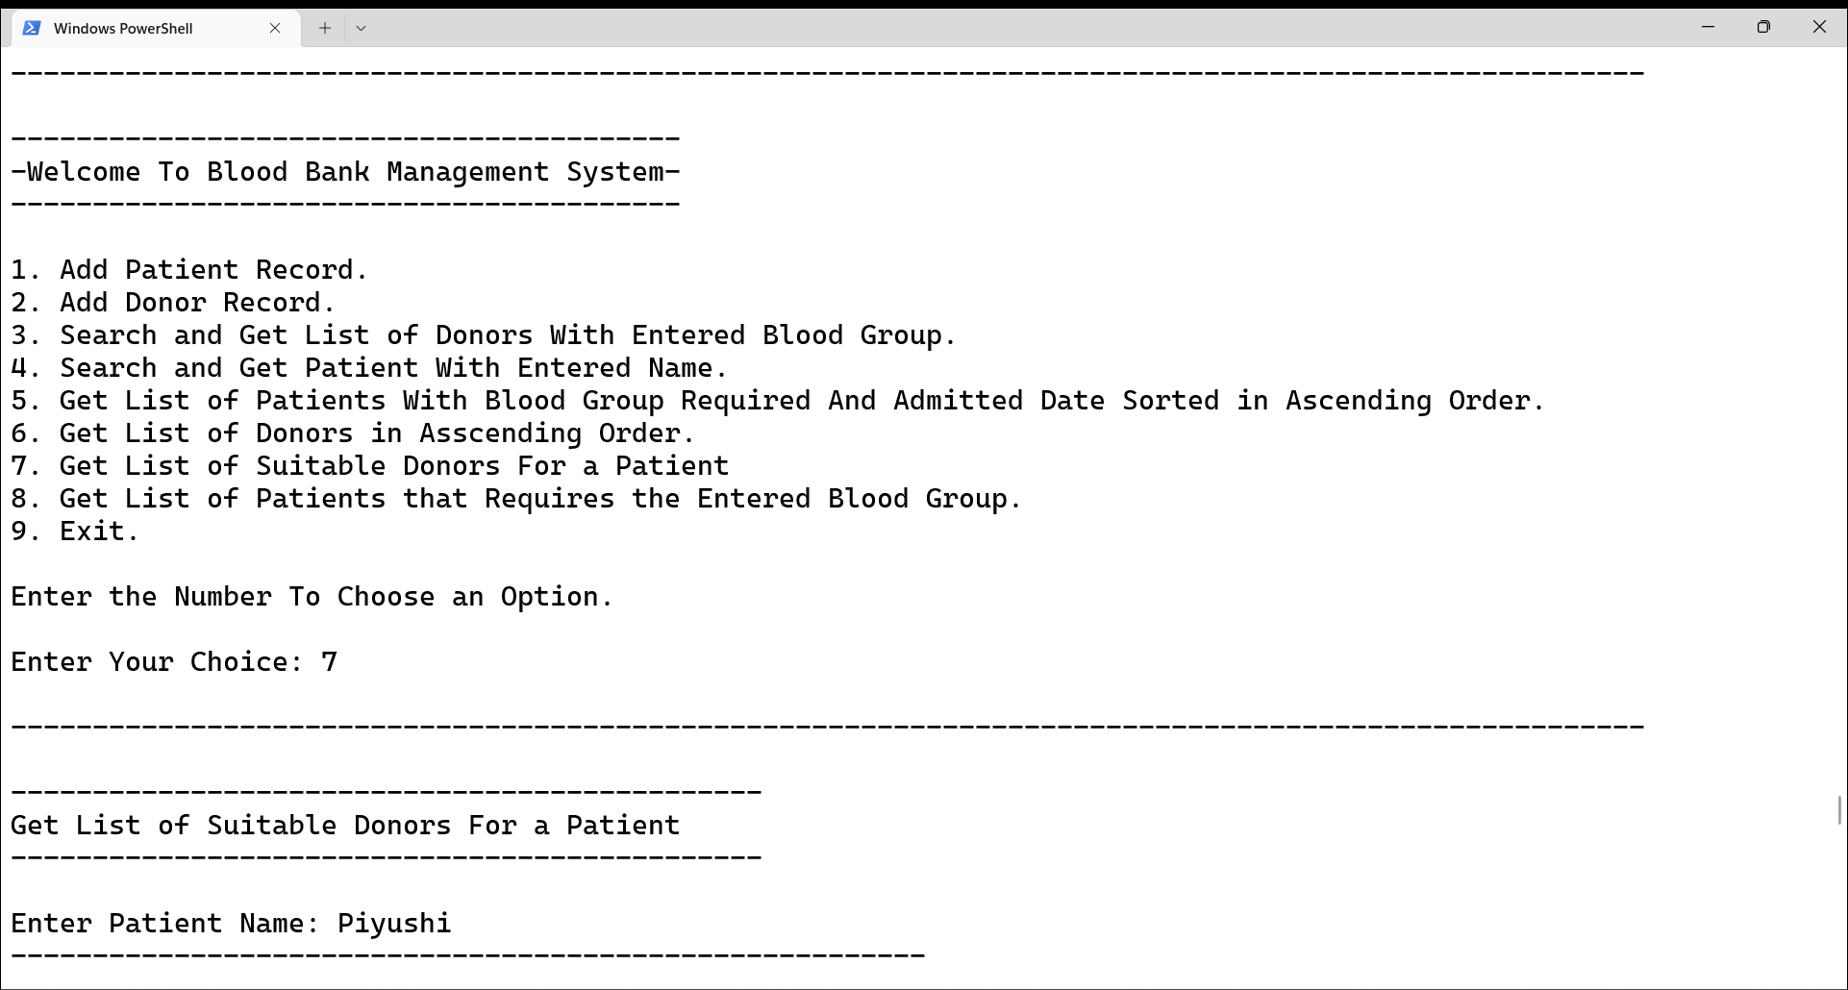

Slide 34
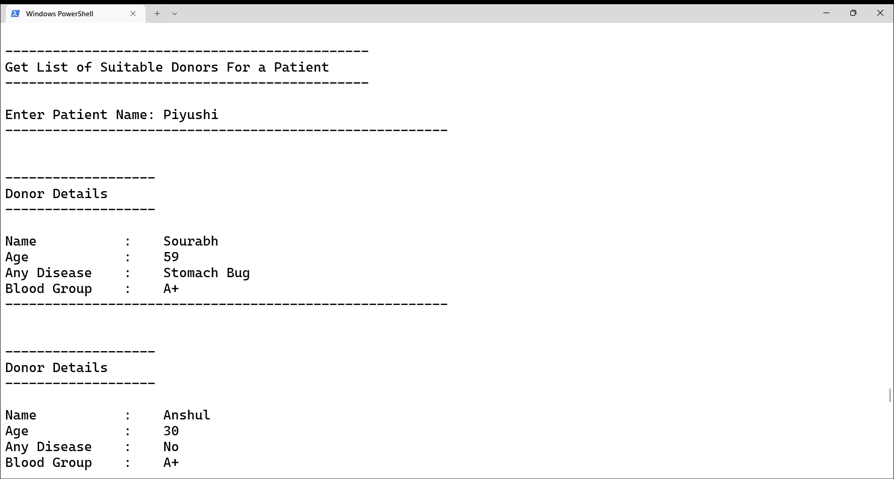

Slide 35
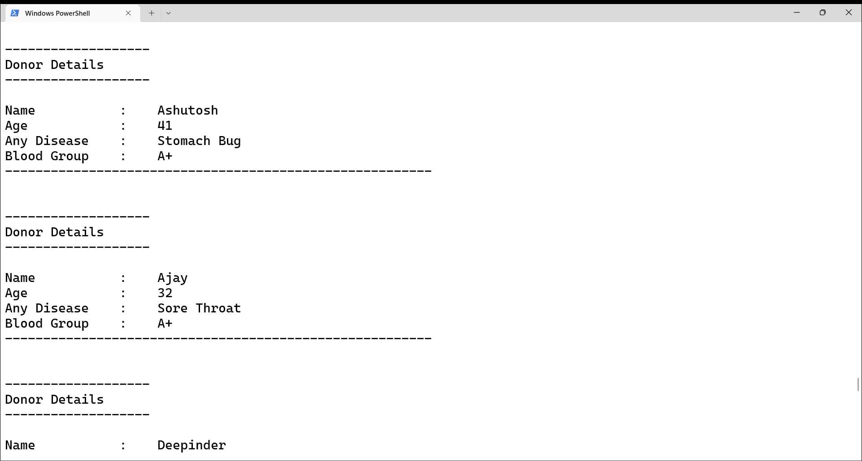

Slide 36
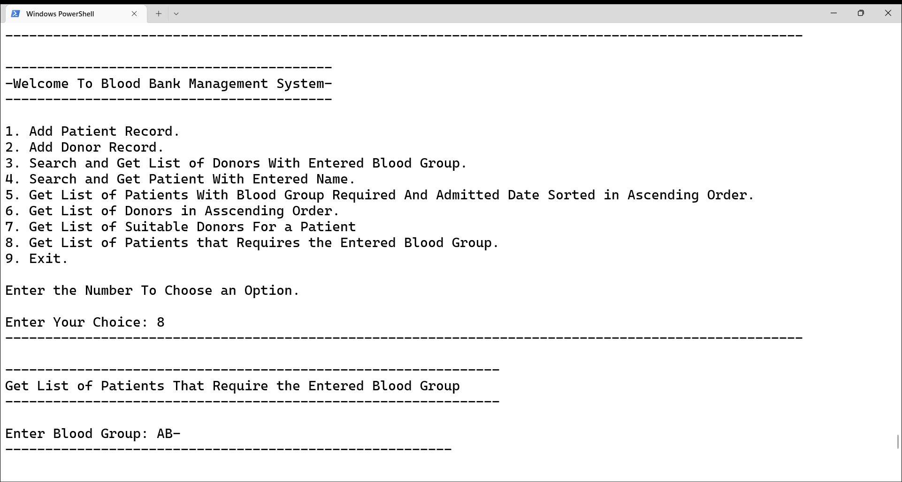

Slide 37
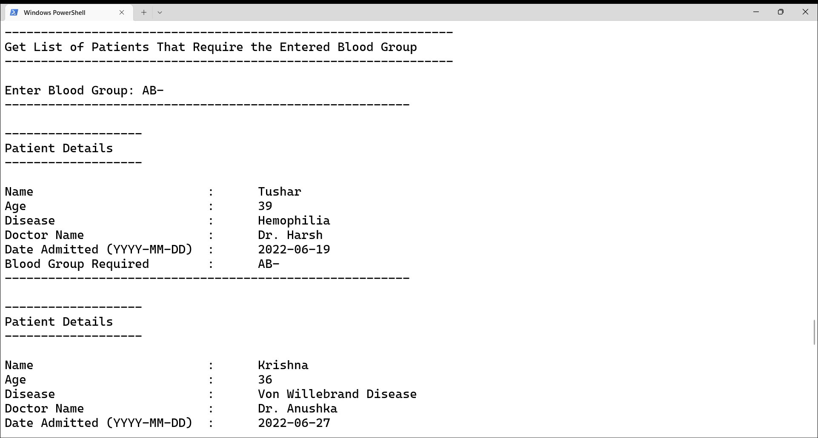

Slide 38
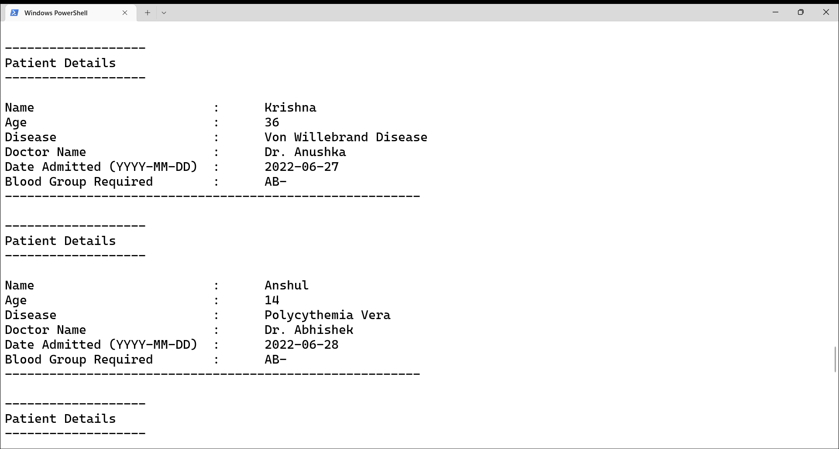

Slide 39
